Slide 1


Slide 2
Introduction
Apache Pig is a high-level platform for creating programs that run on Apache Hadoop. The language for this platform is called Pig Latin
Apache Pig First was Developed at Yahoo Research around 2006.
Apache Pig is used to analyze larger sets of data by representing them as data flows.
Pig Latin can be extended using user-defined functions (UDFs) which the user can write in Java, Python, JavaScript, Ruby or Groovy and then call directly from the language
Apache Pig Works on top of Hadoop.

Slide 3
Why do we need Apache Pig?
Programmers who are not so good at Java normally used to struggle working with Hadoop, especially while performing any MapReduce tasks they can use Apache Pig and Work on Hadoop and do the task
Apache Pig is a Helpful or Beneficial for all such programmers.
Apache Pig provides many built-in operators to support data operations like joins, filter, ordering, etc.

Slide 4
Joins means combine record of two or more relation, filter means it used to select the required tuples from relation based on a condition, Ordering means it used to display the content of a relation in a sorted order based on one or more relation
Apache Pig uses multi-query approach, Means Apache Pig can execute one or more query together.
Pig Latin is SQL-like language and it is easy to learn Apache Pig when you are familiar with SQL.
In addition, it also provides nested data types like tuples, bags, and maps that are missing from MapReduce.

Slide 5
Architecture
To perform a particular task Programmers using Pig, programmers need to write a Pig script using the Pig Latin language, and execute them using any of the execution mechanisms (Grunt Shell, Pig Server).
After execution, these scripts will go through a series of transformations applied by the Pig Framework, to produce the desired output.
Internally, Apache Pig converts these scripts into a series of MapReduce jobs, and the output will be stored in HDFS thus, it makes the programmer’s job easy.

Slide 6
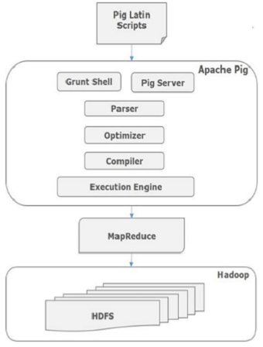
The architecture of Apache Pig is shown below.

Slide 7
Components
Parser:- Does Syntax Checking of the Pig Scripts.
Optimizer:- Optimize Query using several techniques or methods
Compiler:- Compiles gives the output into series of mapreduce job.
Execution Engine:- It takes the responsibility in Hadoop to execute the in mapreduce job, fo that purpose we required mapreduce and whatever result will be there it directly stored in HDFS.

Slide 8
Features
Apache Pig comes with the following features:-
Rich set of operators:− It provides many operators to perform operations like join, sort, filer, etc.
Ease of programming:− Pig Latin is similar to SQL and it is easy to write a Pig script if you are good at SQL.
Optimization opportunities:− The tasks in Apache Pig optimize their execution automatically, so the programmers need to focus only on semantics of the language.

Slide 9
UDF’s:− Pig provides the facility to create User-defined Functions in other programming languages such as Java and invoke or embed them in Pig Scripts.
Handles all kinds of data:− Apache Pig analyzes all kinds of data, both structured as well as unstructured. It stores the results in HDFS

Slide 10
Advantages
Less development time:-It consumes less time while development.
Procedural language:-Apache Pig is a procedural language, not declarative, unlike SQL
Easy to control execution:-We can control the execution of every step because it is procedural in nature
UDFs:-It is possible to write our own UDFs(User Defined Function).

Slide 11
Disadvantages
Errors of Pig:-Errors that Pig produces due to UDFs(Python) are not helpful at all. At times, while something goes wrong, it just gives the error such as exec error in UDF, even if the problem is related to syntax or the type error, it lets alone a logical one.
Not mature:-Pig is still in the development, even if it has been around for quite some time.
Support:-Generally, Google and Stack Overflow do not lead good solutions for the problems.

